Slide 1
Shortcut key
Command + shift + arrow
Function
= SUMIF(A1:A10,”User”,B1:B10)
= IF(logical_test, [value_if_true], [value_if_false])
= IF(A1<10, “low”, IF(A1<20, “middle”, “high”))
= VLOOKUP(lookup_value, table_array, col_index_num, False/True) 精确/模糊
= HLOOKUP(lookup_value, table_array, row_index_num, False/True) 精确/模糊
= RANDBETWEEN(1,4)

Slide 2
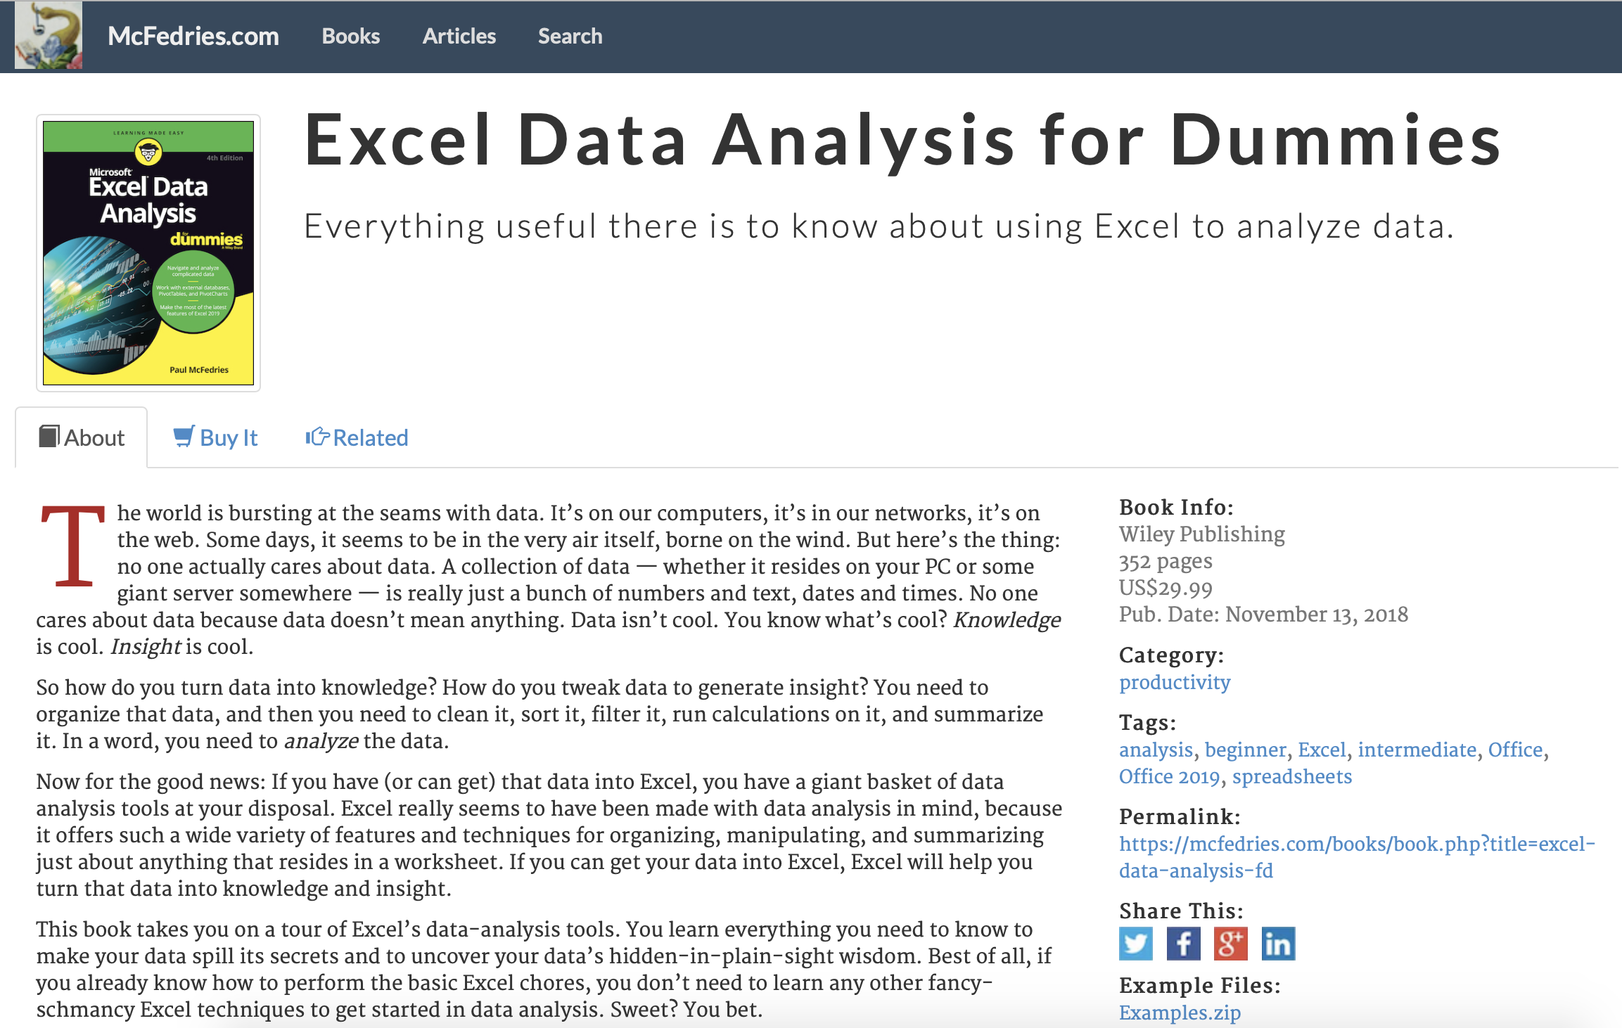
Excel Data Analysis for dummies
Studying Note
https://www.mcfedries.com/books/book.php?title=excel-data-analysis-fd
Click here to download the practice data

Slide 3
Chapter 1 Learning Basic Data-analysis Techniques
Analyzing Data with Conditional Formatting
Highlighting cells that meet some criteria
Showing pesky duplicate values
Highlighting the top or bottom values in a range
Analyzing cell values with data bars
Analyzing cell values with color scales
Analyzing cell values with icon sets
Summarizing Data with Subtotals
Grouping Related Data
Consolidating Data from Multiple Worksheets (Combining multiple worksheets into a summary report.)
Consolidating by position: Worksheets we’re consolidating have an identical layout.
Consolidating by category: Worksheets we’re consolidating have different layouts but common labels.

Slide 4
Chapter 2 Working with Data-Analysis Tools
Analyzing Data with Goal Seek
Goal seek: trying dozens of possibilities to get closer and closer to a solution.
Future value calculation: calculates the future value of an investment given an interest rate, term, and regular deposit.
Working with Data Tables
Data table is special range that excel uses to calculate multiple solutions to a formula.
One-input data table: vary only one of the formula’s input cells.
Two-input data table: vary two formula inputs at the same time.
Skipping data tables when calculating workbooks: Formulas ➮ Calculation Options ➮ Automatic Except for Data Tables
Analyzing Data with Scenarios
Scenario: coherent sets of input values (three or more input values at a time)
Optimizing Data with Solver
When should use solver? Find the optimized parameter for your equation.
break-even analysis, maximized profits, minimize cost, etc.
Save a solver solution as a scenario
Advantages of solver
Solver enables you to specify multiple adjustable cells.
Solver enables you to set up constraints on the adjustable cells.
Solver seeks not only a desired results but also the optimal one.
Solver can generate multiple solutions.

Slide 5
Chapter 3 Introducing Excel Tables
Range ⬄ Table
Choose Range ➮ Insert ➮ Tables (or Command + T)
Choose any cell of Table ➮ Data ➮ Table Tool ➮ Convert to Range
Advanced Filters
Chapter 4 Grabbing Data from External Souces
Import data from
Word table
Text file
Web page
XML file: Cannot realize on Mac excel version
External Databases

